Slide 1
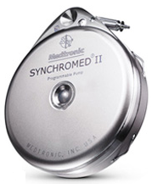
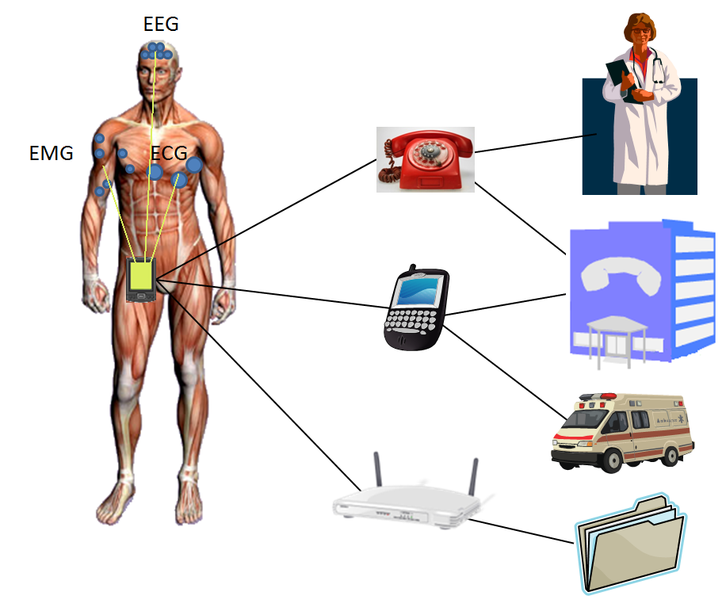
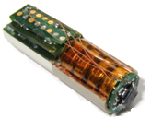
Design Challenges for Secure Implantable Medical Devices
Wayne Burleson
Department of Electrical and Computer Engineering
Shane Clark, Ben Ransford, Kevin Fu, Department of Computer Science
University of Massachusetts Amherst
burleson@ecs.umass.edu
Physical Layer Security
This material is based upon work supported by: the Armstrong Fund for Science; the National Science Foundation under Grants No. 831244, 0923313 and 0964641; Cooperative Agreement No. 90TR0003/01 from the Department of Health and Human Services; two NSF Graduate Research Fellowships; and a Sloan Research Fellowship. Its contents are solely the responsibility of the authors and do not necessarily represent the official views of DHHS or NSF.

Slide 2
Implantable and Wearable Medical Devices
Bio-Medical
EEG Electroencephalography
ECG Electrocardiogram
EMG Electromyography (muscular)
Blood pressure
Blood SpO2
Blood pH
Glucose sensor
Respiration
Temperature
Fall detection
Ocular/cochlear prosthesis
Digestive tract tracking
Digestive tract imaging
Sports performance
Distance
Speed
Posture (Body Position)
Sports training aid
Cyber-human interfaces
Body Area
Network (BAN)
Images courtesy CSEM , Switzerland

Slide 3
Security and Privacy in Implantable Medical Devices
IMD’s are an increasingly important technology
Leveraging many recent technologies in Nano/Bio/Info
Possible solutions to major societal problems
Clinical
Research
Many types of IMDs (see taxonomy coming up)
Security and Privacy increasingly relevant in modern society
Fundamental human rights
Quality of life, Related to safety/health
Acceptance of new technologies
Combining 1. and 2., IMD Security and Privacy involves:
Protecting human life, health and well-being
Protecting health information and record privacy
Engineering Challenges!

Slide 4
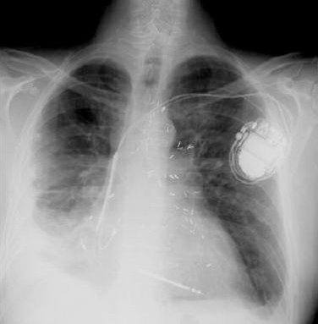
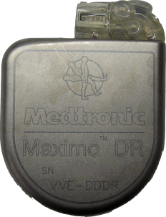
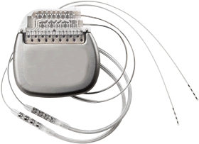
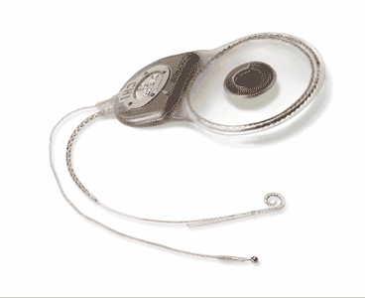
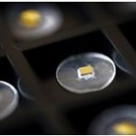
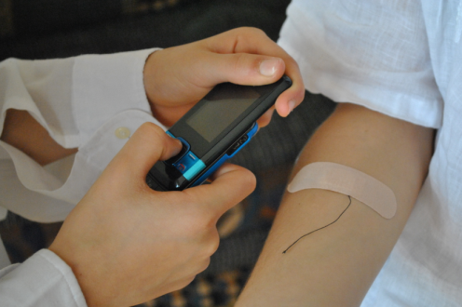
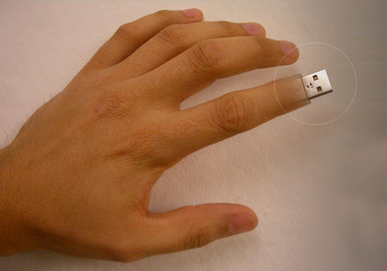
IMD Examples
Existing
Glucose sensor and insulin pump
Pacemaker/defibrillator
Neurostimulator
Cochlear implant
Emerging
Ingestible “smart-pills”
Drug delivery
Sub-cutaneous biosensor
Brain implant
Deep cardiac implant
Smart Orthodontia
Glaucoma sensors and ocular implants
Futuristic
Body 2.0 - Continuous Monitoring of the Human Body
Bio-reactors
Cyber-human Interfaces
Pacemaker - Medtronic
Neurostimulator
Cochlear implant
Smart pill - Proteus biomedical
Subcutaneous biosensor – EPFL-Nanotera
concept illustration from yankodesign

Slide 5
Axes for a taxonomy of IMDs
Physical location/depth, procedure, lifetime,
Sensing/Actuating functions, (sense, deliver drugs or stimulus, grow tissue!)
Computational capabilities
Data storage
Communication: bandwidth, up-link, down-link, inter-device? Positioning system (IPS), distance to reader, noise
Energy requirements, (memory, communication, computation,) powering, harvesting, storage, (battery or capacitive)?
Vulnerabilities. Security functions (access control, authentication, encryption)
Reliability and Failure modes

Slide 6
Security Goals for IMD Design
Incorporate security early.
Encrypt sensitive traffic.
Authenticate third-party devices.
Use well-studied cryptographic building blocks.
Do not rely on security through obscurity.
Use industry-standard source-code analysis.
Develop a realistic threat model.

Slide 7
Threat model – Understand your adversary!
Motives:
Identity Theft
Violence
Insurance fraud
Counterfeit devices
Resources:
Individual
Organization
Nation-state…
Attack vectors:
Wireless interfaces (eavesdropping, jamming, man-in-middle)
Data/control from unauthenticated sources
Data retention in discarded devices

Slide 8

Pacemakers, Defibrillators (UM Amherst, Harvard, Beth Israel)
TR 35
Many medical devices rely on wireless connectivity for remote monitoring, remote therapies and software updates.
Recent research identified several attacks and defenses for implantable cardiac defibrillators
Wireless communications were unencrypted and unauthenticated
Leading to several lethal vulnerabilities
Extensions to numerous other emerging implantable devices
Pacemakers and Implantable Cardiac Defibrillators: Software Radio Attacks and Zero-Power Defenses. D. Halperin, T. Heydt-Benjamin, B. Ransford, S. Clark, B. Defend, W. Morgan, K. Fu, T. Kohno, and W. Maisel. In Proceedings of the 29th Annual IEEE Symposium on Security and Privacy, May 2008. Best Paper Award

Slide 9
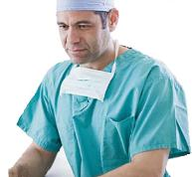
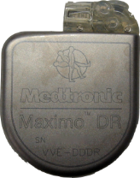

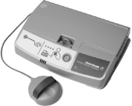
Benefits of Wireless
Easier communication with implant
Remote monitoring
Notes:
Having wireless in these devices has multiple benefits.
First, it makes it easier to communicate with the implant itself.
More importantly, it enables remote monitoring of the patient’s status.
The patient can be in her home; she would have an implant reader that periodically queries the implant for patient’s vital signals. The reader then forwards this information to the medical professionals over the internet.

Slide 10
Benefits of Wireless
Easier communication with implant
Remote monitoring
Reduces hospital visits by 40% and cost per visit by $1800
[Journal of the American College of Cardiology, 2011]
What about security?
Notes:
Studies show that such remote monitoring reduces the number of hospital visits by 40% and also reduces the cost of each clinical visit by about 1800 dollars.
So having wireless in medical implants has many benefits. But, it also brings along new security and privacy issues.

Slide 11
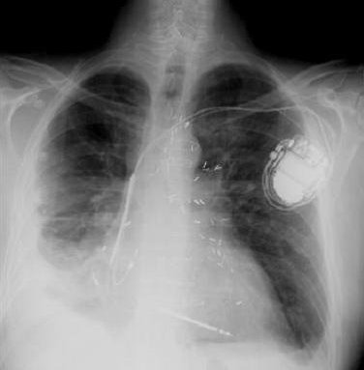

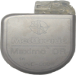

Security Attacks
1) Passive attack: Eavesdrop on private data
Patient diagnosis, vital signs
2) Active attack: Send unauthorized commands
Turn off therapies,
deliver electric shock
[Halperin’08] demonstrated attacks using software radios
Notes:
In particular there are two attacks that are important.
First a passive attack. In this case, the attacker listens on the medium. Whenever the implant transmits, the attacker snoops on these transmission to obtain the patient’s private data. This could be the patient’s diagnosis or vital signal like EKG. Such a snooping is a significant violation of the patient’s privacy.
Second an active attack. In this case the attacker sends unauthorized commands to the implant.
For example, the attacker here can send wireless commands which turn off therapies on the implant.
These passive and active attacks are not just fantasies. They have been demonstrated in practice using off-the-shelf software radios. For example, the researchers have showed that an attacker can make a cardiac defibrillators deliver an electric shock to the patient’s heart.

Slide 12
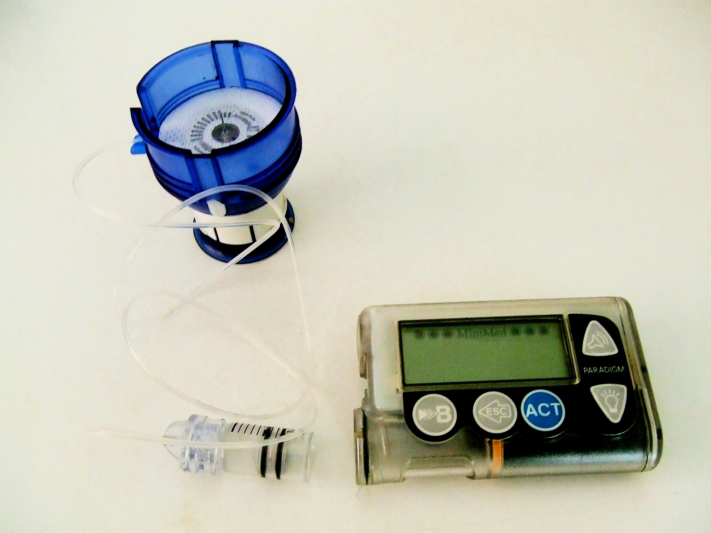
Insulin Pump Systems
Patient-controlled open-loop systems used to monitor and stabilize glucose levels.
Several researchers have highlighted security and privacy risks in insulin pump systems.
Wireless forgery of insulin readings
Wireless administration and potentially fatal over-dosage.
C. Li, A. Raghunathan, and N. K. Jha. Hijacking an insulin
pump: Security attacks and defenses for a diabetes therapy
system. In Proceedings of the 13th IEEE International
Conference on e-Health Networking, Applications, and
Services, Healthcom ’11, June 2011.
N. Paul, T. Kohno, and D. C. Klonoff. A review of the
security of insulin pump infusion systems. Journal of
Diabetes Science and Technology, 5(6):1557–1562,
November 2011.

Slide 13
Cross-cutting Concerns
When and how to apply encryption
Authentication and Key management
Lightweight ciphers (stream and block)
Physical layer security
Appropriate failure modes
Novel approaches to authentication
Ultrasonic distance-bounding
Auxiliary “helper” devices
PUFs
Cyber-human systems
Human on both ends of the system
Controlling
Sensing
Humans in the loop

Slide 14
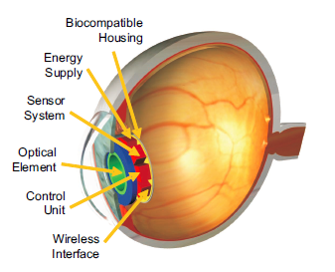
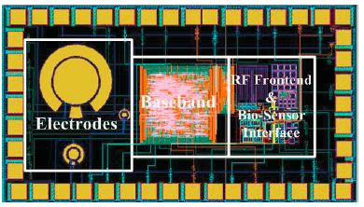
Lightweight Cryptography for Bio-sensors
AES Block Cipher
Hummingbird Stream Cipher
Ocular implant
Glucose sensor
C. Beck, D. Masny, W. Geiselmann, and G. Bretthauer.
Block cipher based security for severely resource-constrained implantable medical devices. International Symposium on Applied Sciences in Biomedical and Communication Technologies, ISABEL 2011.
S. Guan, J. Gu, Z. Shen, J. Wang, Y. Huang, and A. Mason.
A wireless powered implantable bio-sensor tag system-on-chip for continuous glucose monitoring. BioCAS 2011.

Slide 15
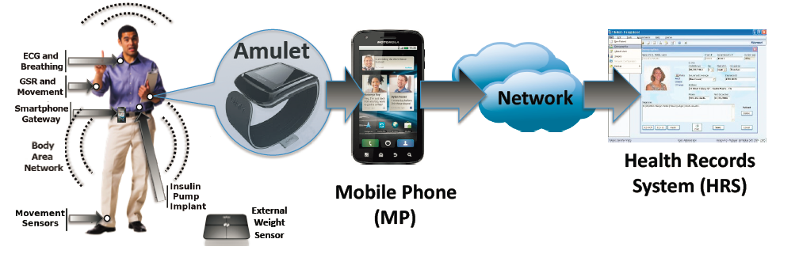
External “protector devices”
Sorber et al (Dartmouth), An Amulet for trustworthy wearable mHealth, HotMobile 2012

Slide 16
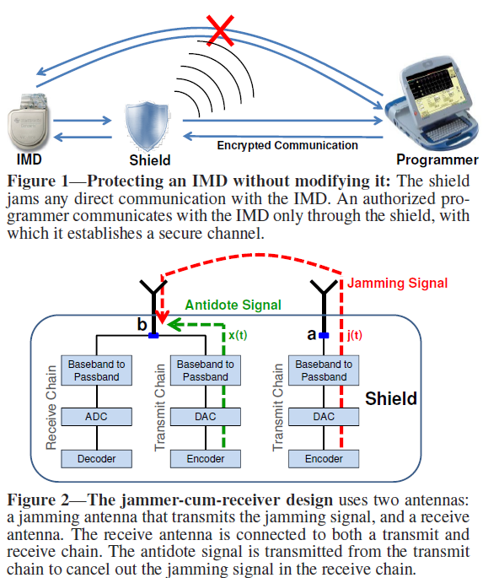
Protecting existing IMDs
Gollakota et al (MIT, UMASS), They Can Hear Your Heartbeats: Non-Invasive Security for Implanted Medical Devices, SIGCOMM 2011 (Best Paper)

Slide 17
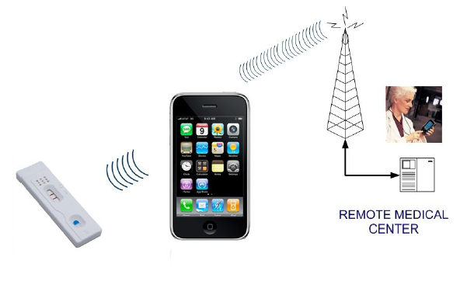

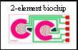
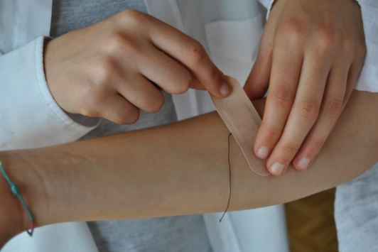
Secure Platform for Bio-sensing (Umass, EPFL, Bochum)
Applications
Disposable Diagnostic
Low-cost, infectious disease detection (malaria, HIV, dengue, cholera)
Implantable Device
Sub-cutaneous multi-function sensor (drugs, antibodies)
Glucose/Lactate in Trauma victims
Security Technology
NFC Cell Phone
EPC Class 1, Gen 2 protocol
PRESENT Block Cipher (Encryption, Signing, Authentication)
PUF for low-cost ID and Challenge-Response
Disposable Diagnostic
Implanted Devices
Images: Disposable Diagnostic: Gentag.com,
Sub-cutaneous Implant: LSI, EPFL, NanoTera
2-element biochip: CBBB, Clemson University

Slide 18
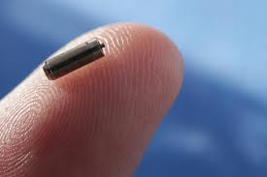
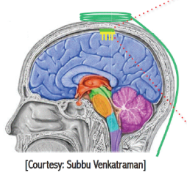
Power/Energy Challenges
Remote powered systems (RFID) limited to 10’s of microwatts
Near field powering improves this to milliwatts
Current energy harvesting systems similarly limited…
Small batteries typically store several 1000 Joules.
Over several years of operation, this translates to 10’s of microwatts
Batteries are still large and heavy
Rechargable batteries dissipate
heat and have safety concerns
Non-rechargeable batteries
require surgery for replacement
Brain implants can not incur more than 1 degree Celsius temperature gradient without safety concerns

Slide 19
Design Tension Challenges
Safety/Utility goals
Security/Privacy goals
Authorization (personal, role-based, IMD selection)
Availability
Device software and settings
Device-existence privacy
Device-type privacy
Specific-device ID privacy
Measurement and Log Privacy
Bearer privacy
Data integrity
Data access
Data accuracy
Device identification
Configurability
Updatable software
Multi-device coordination
Auditable
Resource efficient
From D. Halperin et al, “Security and Privacy for Implantable Medical Devices”, IEEE Pervasive Computing, 2008

Slide 20
Design for Medical is different!
“Medical marches to a different cadence than most of the electronics industry. Design cycles can stretch from three to five years and cost $10-15 million, thanks to the lengthy regulatory process. The product lifecycles can also extend over a 20 year time span.”
Boston Scientific
What is the role of FDA and other regulators?
- FDA currently regulates safety, but not security

Slide 21
Trends in VLSI Research
Driving Applications
Microprocessors
DSP
Video
Wireless
Hand-sets
Smart Cards
Sensor Networks
RFID
Medical Devices
Smart Dust
…
Design Challenges
Area
Performance
Complexity
Test/Yield
Power
Flexibility
Reliability
Process
Voltage
Temperature
Security/Privacy
1970’s
1980’s
1990’s
2000’s
2010’s

Slide 22


Global cross-disciplinary efforts needed!
Speakers:
K. Fu Umass Amherst, USA
S. Capkun, ETHZ, CH
S. Carrara, EPFL, CH
J. Huiskens, IMEC, NL
A. Sadeghi, Darmstadt, DE
I. Brown, Oxford, GB
F. Valgimigli, Metarini, IT
A. Guiseppi-Elie, Clemson, USA
S. Khayat, UFM, Iran
Q. Tan, Shanghai, China
Panel : How real and urgent are the security/privacy threats for IMDs? Which IMDs?
Springer Book underway, to appear early 2013
Workshop on Security and Privacy in Implanted Medical Devices April 1, 2011 EPFL, Lausanne, Switzerland
(co-located with IEEE ISMICT in nearby Montreux, Switzerland, www.ismict2011.org)
http://si.epfl.ch/SPIMD

Slide 23

in the USA…
sharps.org
SHARPS is a multi-institutional and multidisciplinary research project, supported by the Office of the National Coordinator for Health Information Technology, aimed at reducing security and privacy barriers to the effective use of health information technology. The project is organized around three major healthcare environments:
Electronic Health Records (EHR)
Health Information Exchange (HIE)
Telemedicine (TEL)
A multidisciplinary team of computer security, medical, and social science experts is developing security and privacy policies and technology tools to support electronic use and exchange of health information.
UIUC, Stanford, Berkeley, Dartmouth, CMU, JHU, Vanderbilt, NYU, Harvard/BethIsrael, Northwestern, UWash, UMass

Slide 24
Conclusions
Implantable Medical Devices have unique challenges in Security and Privacy
Critical assets
Resource constraints (power/energy, size)
Hard to maintain
Long lifetime
Human factors
Security/Safety tradeoffs
But solutions can leverage unique aspects of IMDs
Proximity, in-body location
Data-rates
Threat models
Need to work with IMD designers and users
Much work to be done
Cyber-physical and cyber-human systems
Many exciting new IMDs
Many possible new threats

Slide 25
Backup/Q&A slides

Slide 26
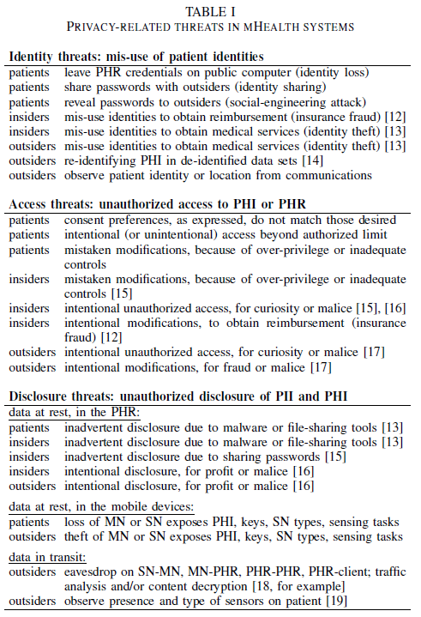
Threat taxonomy
D. Kotz, A threat taxonomy for mHealth privacy, NetHealth 2011

Slide 27
Smart pills
Raisin, a digestible, ingestible microchip, can be put into medicines and food. Chip is activated and powered by stomach acids and can transmit to an external receiver from within the body! Useful for tracking existence and location of drugs, nutrients, etc.
Ingestible Raisin microchip
“…there’s more silicon in a banana…” - Proteus CTO
Proteus Biomedical

Slide 28
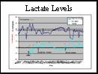
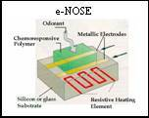
Bio-sensors for hemorrhaging trauma victims
Implantable biosensor for monitoring lactate and glucose levels. Funded by the US Department of Defense
Developing a temporary implantable dual sensing element biochip with wireless transmission capabilities.
Applications in mass triage scenarios such as battlefields and natural disaster sites provide a means for medical personnel to make life saving decisions.
Low-cost, short life-time, rapid deployment, life-saving
Future applications in diabetes care,
transplant organ health, and intensive care.
A. Guiseppe-Elie, C3B, Clemson University (USA)

Slide 29
Security and Privacy Design Issues
System Requirements
Sensor/Actuator Functionality, Software updates
Communications: Data-rate (>100kbps), Range/Channel (BAN)
Protocol Design: Asymmetric channel, ( Active RFID)
Design Constraints
Power (battery-powered, harvested, or remote-powered device)
Size, Bio-compatibility, calibration
Long life-time, little maintenance, reliability
Security Analysis
Assets: Human health and well-being, personal and health data
Threats: Device cloning and counterfeiting, Eavesdropping, Physical Layer Detection and Identification,
Security Primitives
Public and private key crypto, block and stream ciphers, TRNG, PUF
Secure radios, Distance-bounding protocols, etc.

Slide 30
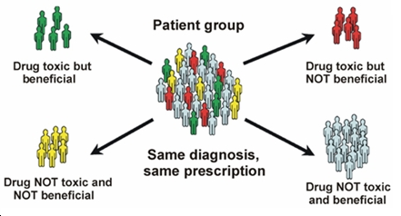
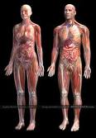
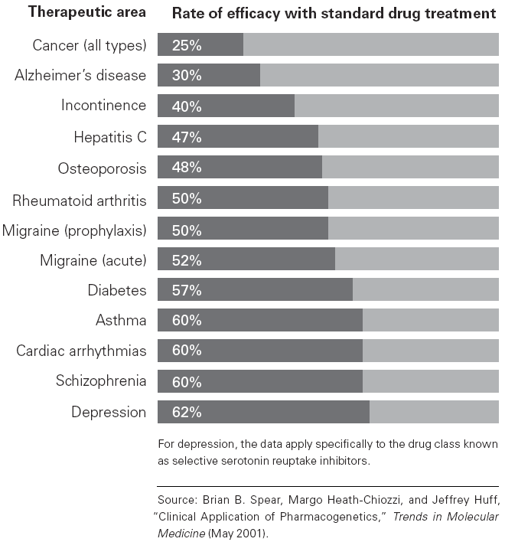
Personalized Therapies with multiple IMDs
3.Therapy
2.Data Analysis
1.Drug/marker
detection
The Development of new Implantable Medical Devices
is a key-factor for succeeding in Personalized therapy

Slide 31


